Slide 1
Spatio-Temporal Resource Search Final Presentation
Team 2:
Imran Choudhury
Rajan Bhandari
Sreejith Menon
Thomas Dutta

Slide 2
Agenda
Evaluation of algorithms implemented
Simulation methodology
Baseline and Gravitational Pull Algorithm Demo
Results

Slide 3
Overview of implemented algorithms
Uninformed Search Algorithm
Greedy resource search based on shortest distance (Baseline Algorithm)
Gravitational Pull Algorithm (GPA) for resource search
Historical Knowledge Based Search Algorithm
Gravitational Pull Algorithm (GPA) for resource search using average expected availability
Real-time Knowledge Based Search Algorithm
Gravitational Pull Algorithm (GPA) with real time data

Slide 4
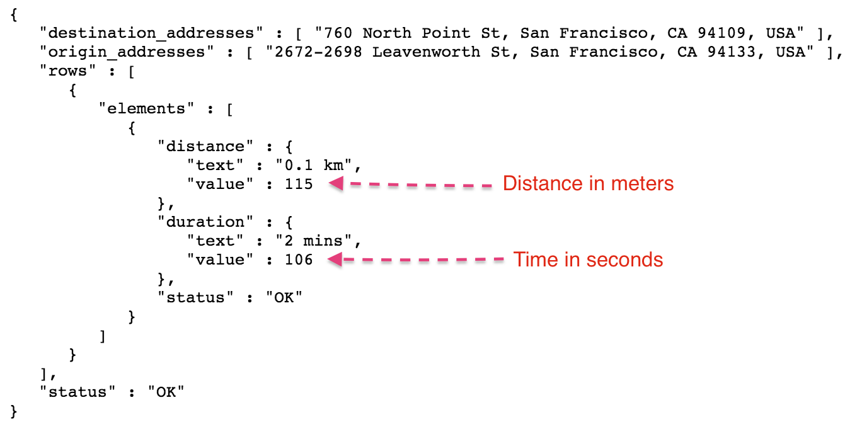
Pre-Computations
Used Google Maps Distance Matrix API to calculate distance between
Every pair of intersections
Every pair of intersections and parking blocks
Distances stored in MySQL database to remove network bottleneck and limited quotas of API calls.

Slide 5
Simulation
Executed Uninformed Search Algorithm, Historical Knowledge Based Search Algorithm and Real-time Knowledge Based Search Algorithm with every node as source location for 8 different timings.
Simulated different congestion levels (0%, 30% and 60%) for all the algorithms.

Slide 6
Uninformed Search Algorithm 1 (Baseline)
Greedy approach
Algorithm Steps:
Calculate distance from source to all parking blocks
Select and route to the nearest parking block
Once arrived, check if available
If available stop otherwise, repeat steps

Slide 7
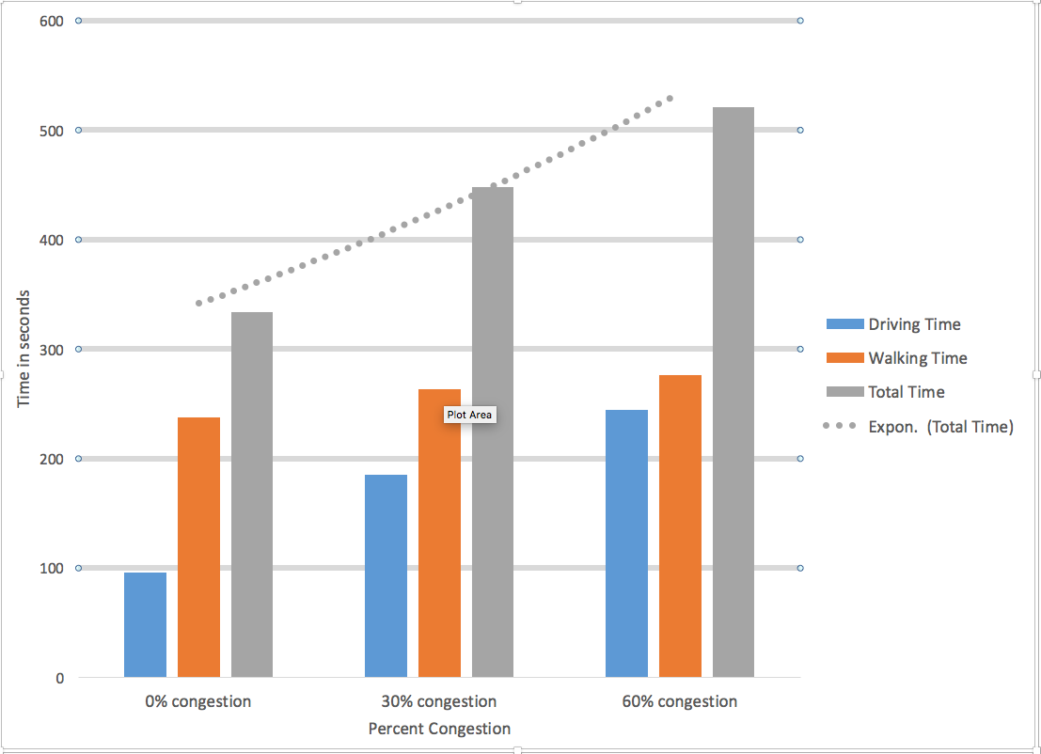
Uninformed Search Algorithm 1 Results

Slide 8
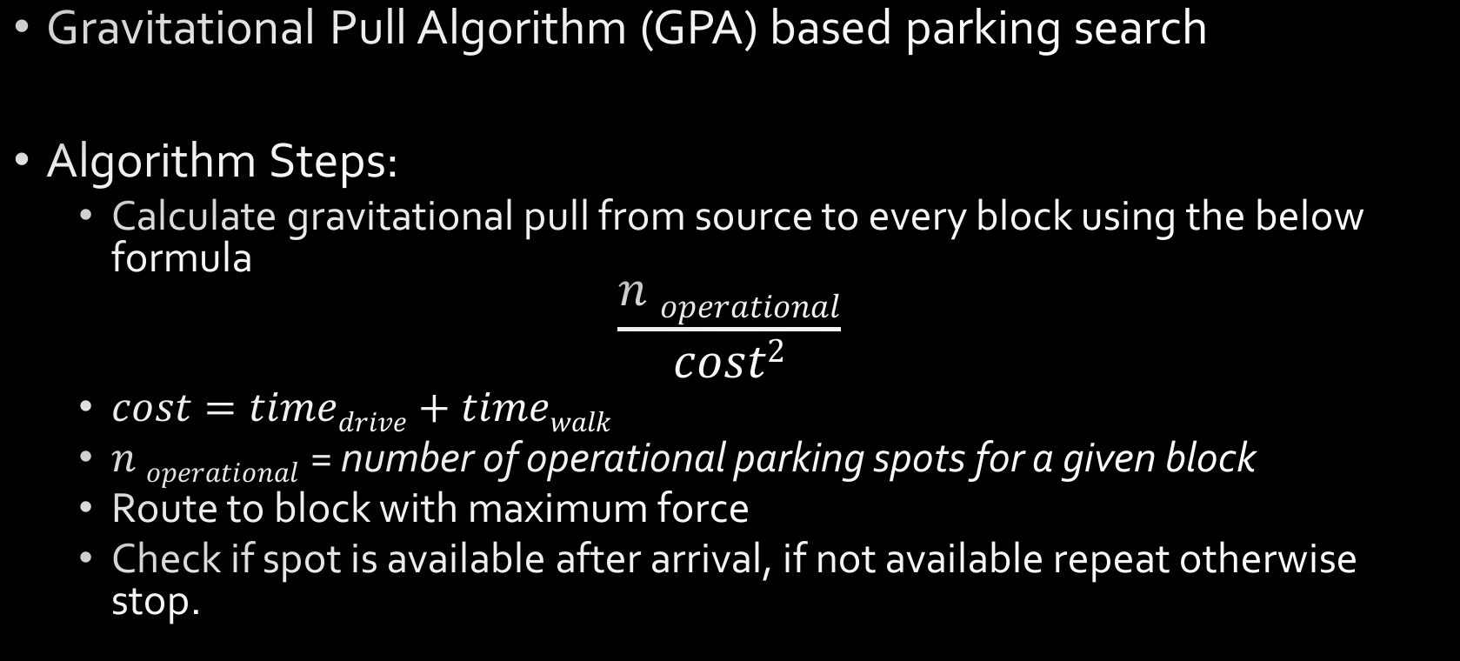
Uninformed Search Algorithm 2
Gravitational Pull Algorithm (GPA) based parking search
Algorithm Steps:
Calculate gravitational pull from source to every block using the below formula
$$\frac{n operational}{cost2}$$
$cost=timedrive+timewalk$
$n operational$ = number of operational parking spots for a given block
Route to block with maximum force
Check if spot is available after arrival, if not available repeat otherwise stop.

Slide 9
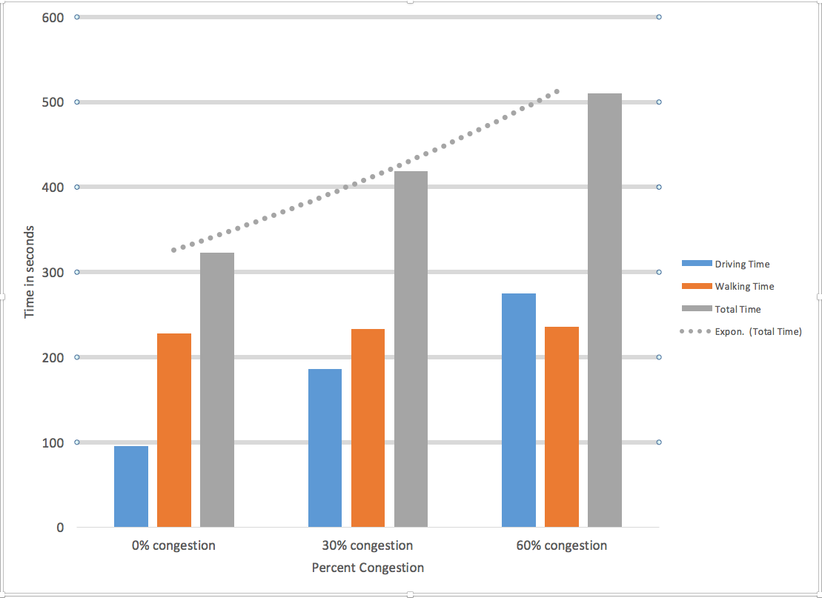
Uninformed Search Algorithm 2 Results

Slide 10
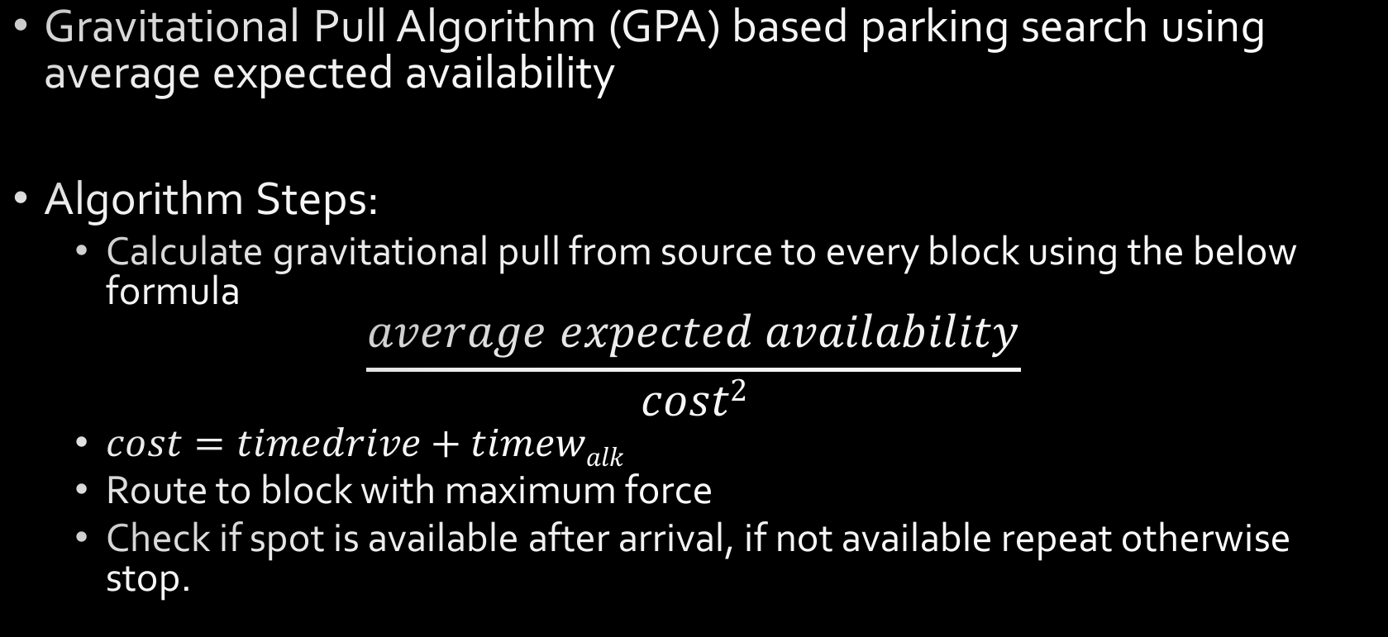
Historical Knowledge Based Search Algorithm
Gravitational Pull Algorithm (GPA) based parking search using average expected availability
Algorithm Steps:
Calculate gravitational pull from source to every block using the below formula
$$\frac{average expected availability}{cost2}$$
$cost=timedrive+timewalk$
Route to block with maximum force
Check if spot is available after arrival, if not available repeat otherwise stop.

Slide 11
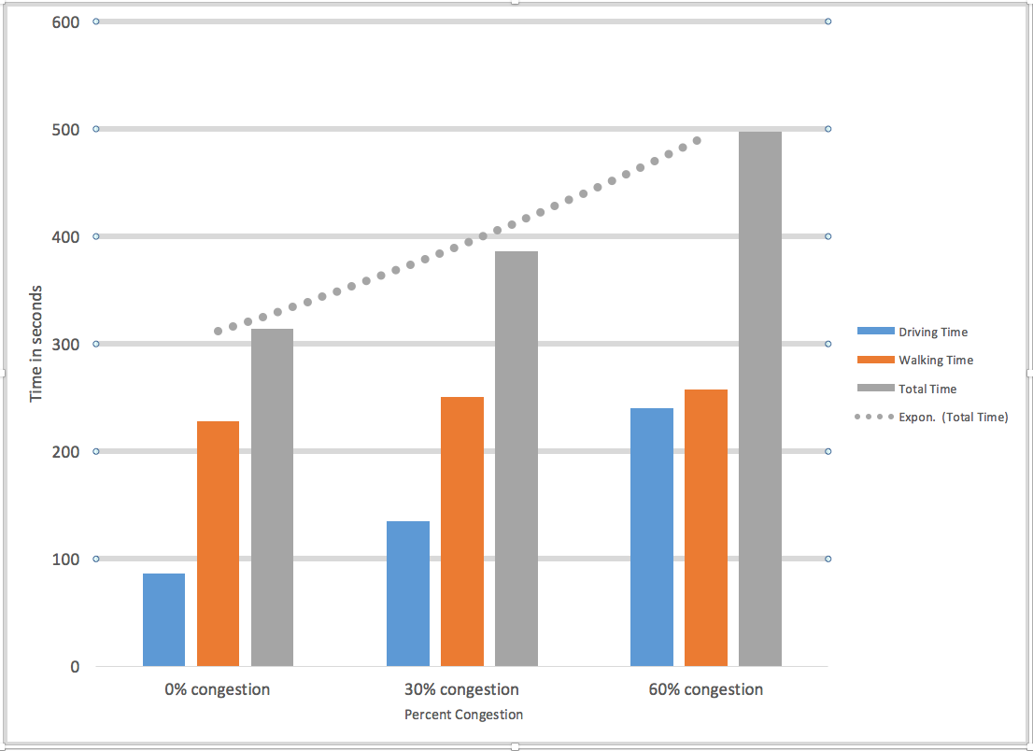
Historical Knowledge Based Search Algorithm Results

Slide 12
Real-time Knowledge Based Search Algorithm
Implementation based on paper “Spatio-temporal Matching Algorithms for Road Networks” - Daniel Ayala, Ouri Wolfson, Bo Xu, Bhaskar DasGupta
Technique used - Deterministic Magnitude GRA (DM-GRA)
Key points of the algorithm
Every road intersection has outgoing edges which determine possible directions
Every parking block exerts force on driving car
Car will move in the direction which has maximum magnitude of sum of forces

Slide 13
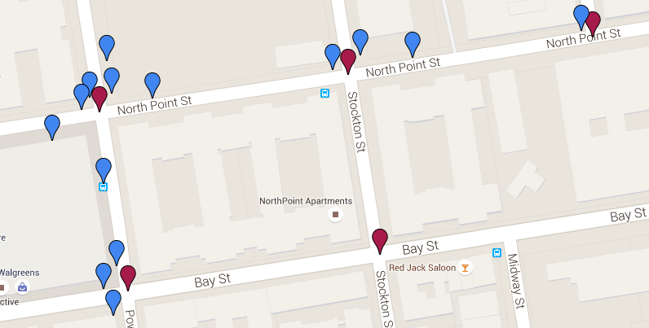
GPA - Deterministic Magnitude GRA
Car moves in the direction where sum of forces from parking blocks is maximum

Slide 14
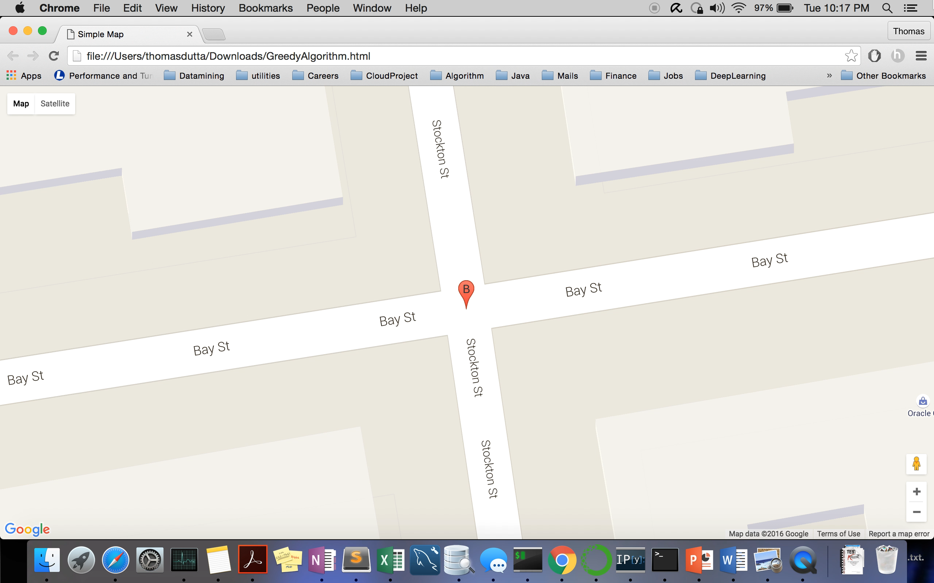

Slide 15
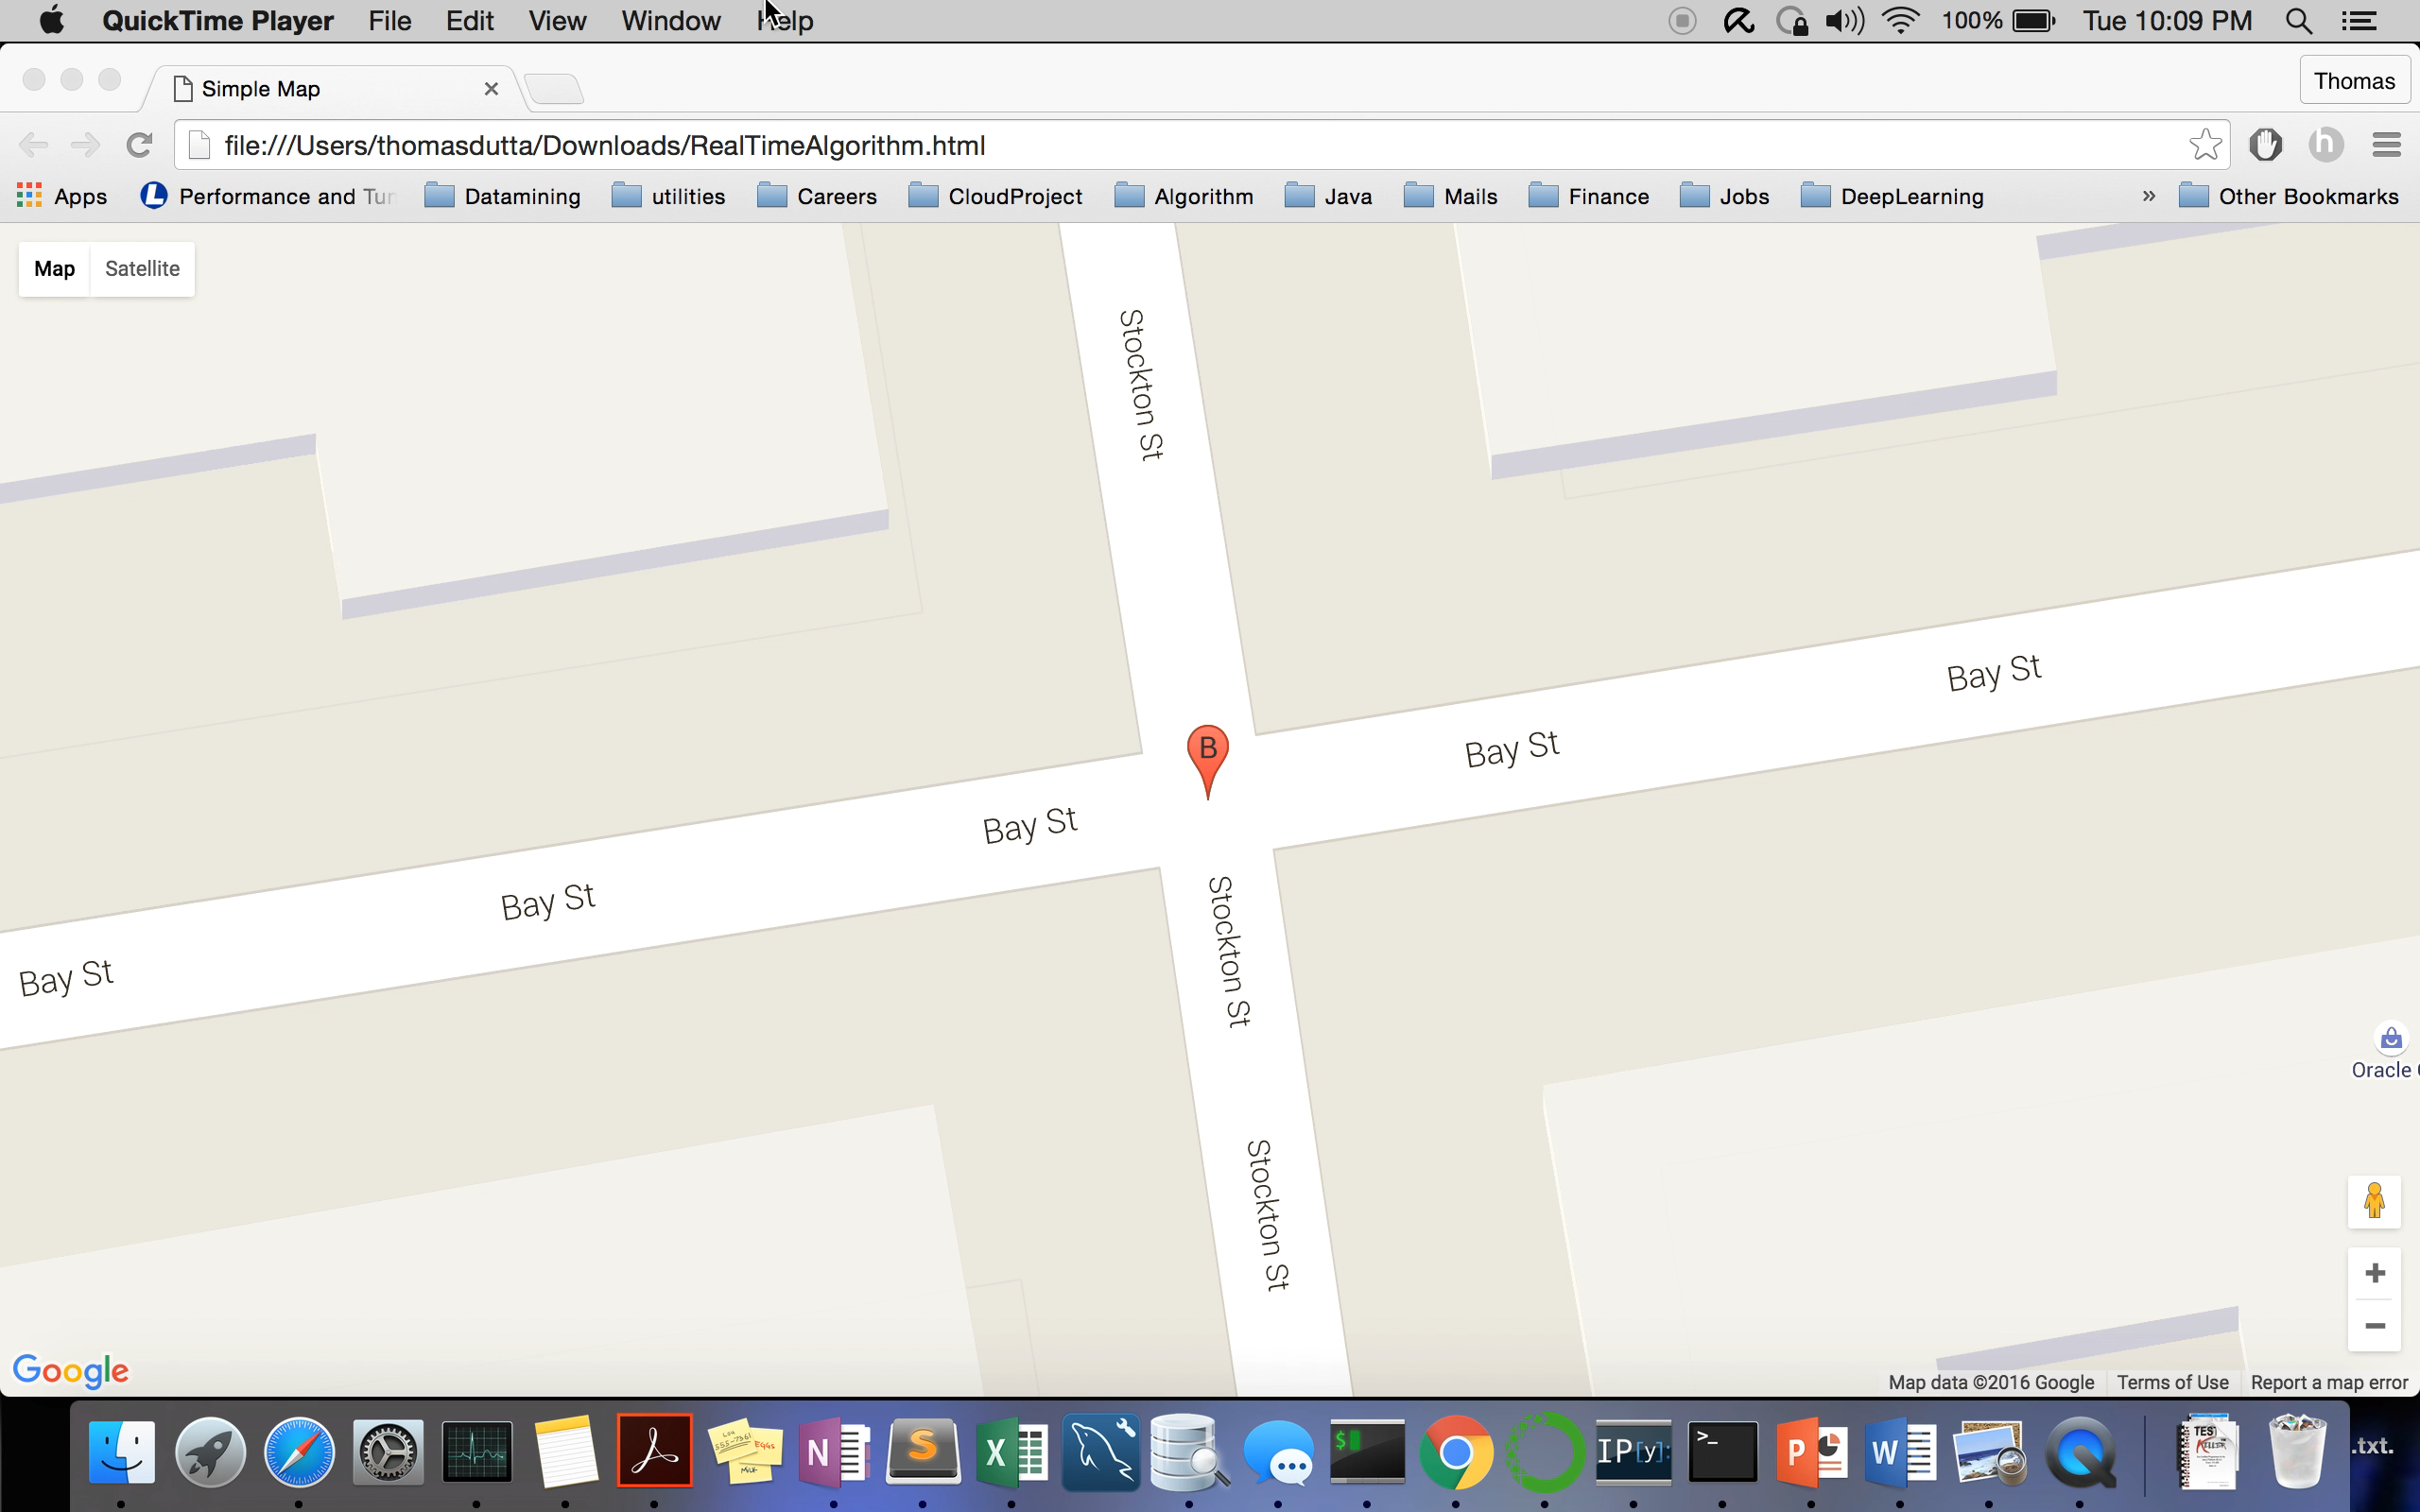

Slide 16
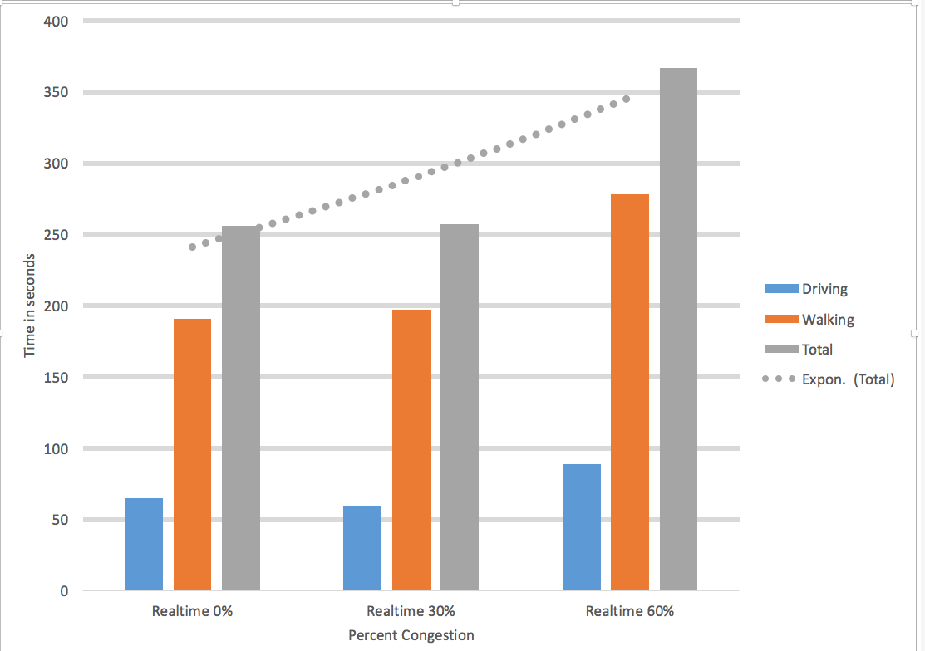
Real-time Knowledge Based Search Algorithm Results

Slide 17
Baseline versus Real-time GPA
Experimental sample
Start point: 37.806054, -122.410329
Destination: 37.8069412593,-122.4112306377
Request time: 2012-04-06 00:06:32
Congestion Level: 0%
 | Baseline | Real-time GPA | Total savings
Drive time (seconds) | 81 | 62 | 19
Walking time (seconds) | 125 | 125 | 0
Total time (seconds) | 206 | 187 | 19

Slide 18
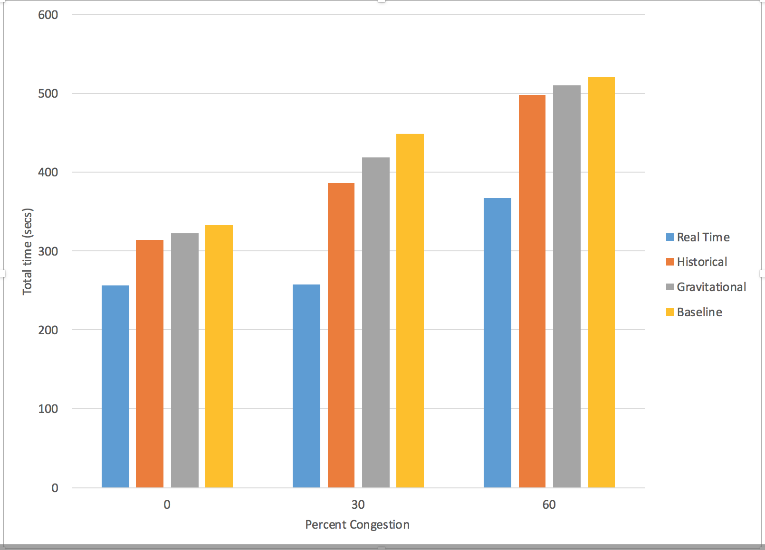
Comparison of all algorithms

Slide 19
Tools used
Python 3.5
Jupyter IPython Notebook
MySQL
Google Maps Distance Matrix API
Google Maps Directions Service API

Slide 20
THANK YOU!

